Slide 1

Web Programming Part II
by Patcharapol Jirasrisopa (Q) Computer System Administrator Group
King Mongkut’s Institute of Technology Ladkrabang

Slide 2
Web Programming Part I
PHP Intro
PHP Install
PHP Syntax
PHP Variables
PHP String
PHP Operators
PHP If...Else
PHP While Loops
PHP For Loops
PHP Forms
PHP $_GET
PHP $_POST
Notes:
กล่าวทบทวนใน part แรก

Slide 3
Agenda
Loops
Introduction to forms
How to write form in HTML?
How to receive data in PHP?
Applications

Slide 4
Loops
For loop
While loop
Applications

Slide 5
For loop
Syntax
for(initial;expression;change){
statement
}
initial
False
expression
True
statement
change

Slide 6
For loop (continue)
initial
Example
for($i=0;$i<=10;$i++){
echo $i.“<br>”;
}
for($i=10;$i>=0;$i--){
echo $i.“<br>”;
}
0
1
2
.
.
.
10
False
expression
True
statement
change
10
9
8
.
.
.
0

Slide 7
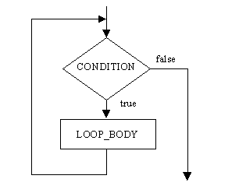
While loop
Syntax
while(CONDITION){
LOOP_BODY
}
False

Slide 8
While loop (continue)
Example
$i=2010;
while($i<2013){
echo $i.“,”;
$i=$i+1;
}
2010,2011,2012,

Slide 9
Applications
Example
$n=3;
for($i=1;$i<=12;$i++){
echo $n.“x”.$i.“=”.($n*$i).“<br>”;
}
3x1=3
3x2=6
3x3=9
3x4=12
3x5=15
3x6=18
3x7=21
3x8=24
3x9=27
3x10=30
3x11=33
3x12=36
3x1=3
3x2=6
3x3=9
.
.
.

Slide 10
Agenda
Loops
Introduction to forms
How to write form in HTML?
How to receive data in PHP?
Applications

Slide 11
Introduction to forms
What is form?
How it work?
GET/POST Method

Slide 12
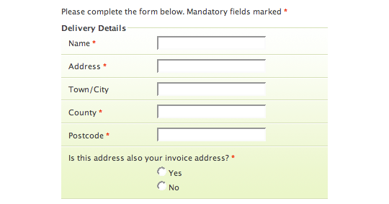
What is form?
Form (web), a document form used on a web page to, typically, submit user data to a server (http://en.wikipedia.org/wiki/Form)
Notes:
Picture 1 : http://matblog.de/uploads/internet/form_example.png

Slide 13
How it work?
HTML index.html
GET/POST Method
PHP form.php

Slide 14
GET Method
HTML index.html
GET Method
PHP form.php
URL:
form.php?name=Q&birth_year=1992&faculty=engineering&department=computer&college=KMITL
name=Q birth_year=1992 faculty=engineering department=computer college=KMITL

Slide 15
POST Method
HTML index.html
POST Method
PHP form.php
URL:
form.php
name=Q birth_year=1992 faculty=engineering department=computer college=KMITL

Slide 16
Agenda
Loops
Introduction to forms
How to write form in HTML?
How to receive data in PHP?
Applications

Slide 17
How to write form in HTML?
Form element
Input element
Select element
Demonstration
Try it self !!!

Slide 18
Form element
<FORM> … </FORM>
Attribute of form
action process url of server-side (Require)
method method used to submit the form (Default : GET)

Slide 19
Form element (continue)
Example I
<FORM action=“http://localhost/form.php”> …input element…
</FORM>
Example II
<FORM action=“http://localhost/form.php” method=“POST”>
…input element…
</FORM>

Slide 20
Input element
<INPUT />
Attribute of input
type kind of input
name name of element
value initial value for element

Slide 21
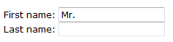
Input element (continue)
type:text
<FORM> First name: <INPUT type="text" name="fname" value="Mr.“ /><br /> Last name: <INPUT type="text" name="lname" /> </FORM>

Slide 22
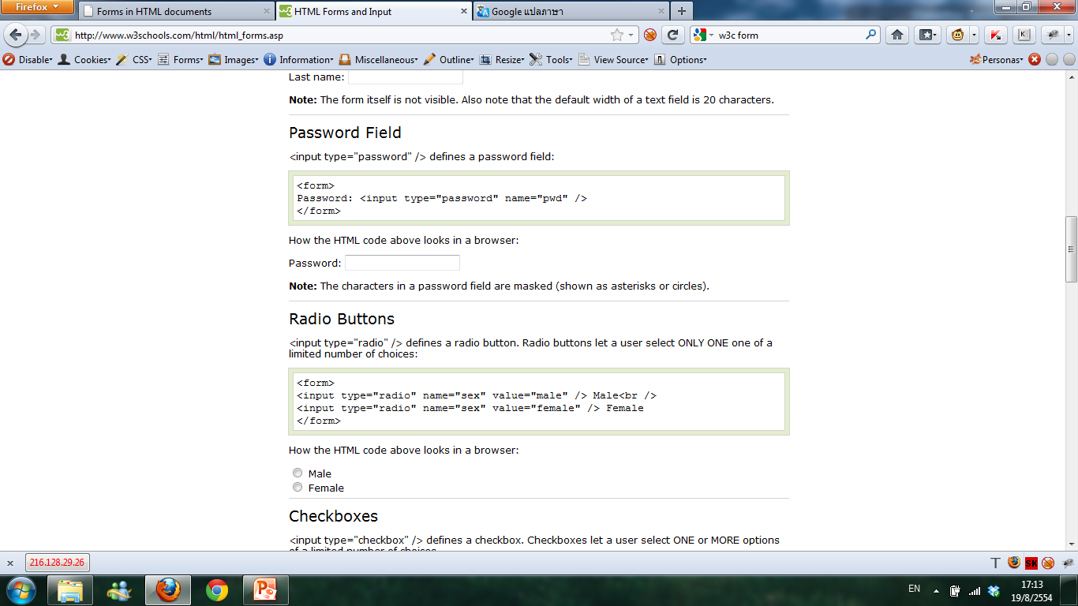
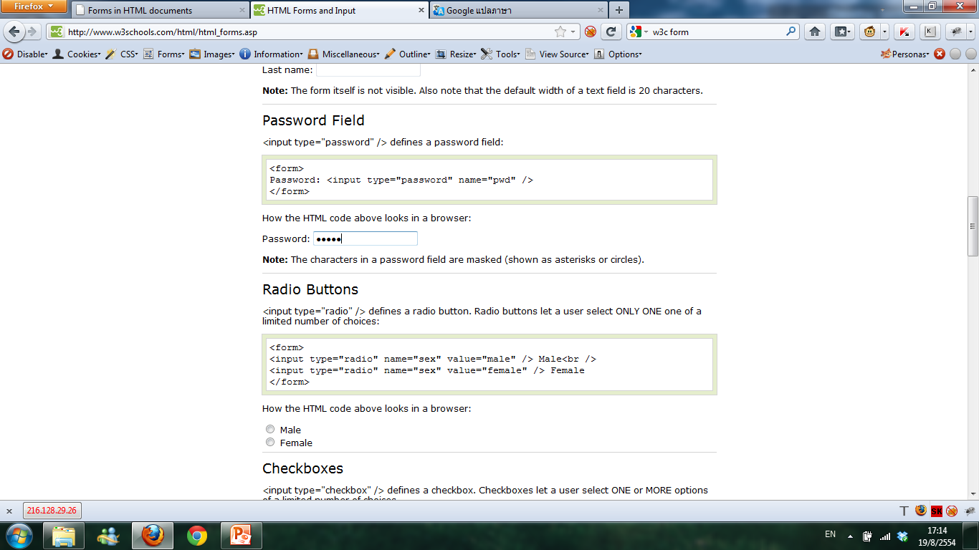
Input element (continue)
type:password
<FORM> Password: <INPUT type="password" name="pwd" /><br /> Password: <INPUT type="password" name="pwd“ value=“12345” /> </FORM>

Slide 23
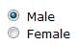
Input element (continue)
type:radio
<form> <input type="radio" name="sex" value="male" checked /> Male<br /> <input type="radio" name="sex" value="female" /> Female </form>

Slide 24
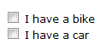
Input element (continue)
type:checkbox
<form> <input type="checkbox" name="vehicle" value="Bike" /> I have a bike<br /> <input type="checkbox" name="vehicle" value="Car" /> I have a car </form>

Slide 25
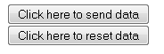
Input element (continue)
type:submit/reset
<form> <input type="submit" value="Click here to send data" /><br /> <input type="reset" value="Click here to reset data" /> </form>

Slide 26
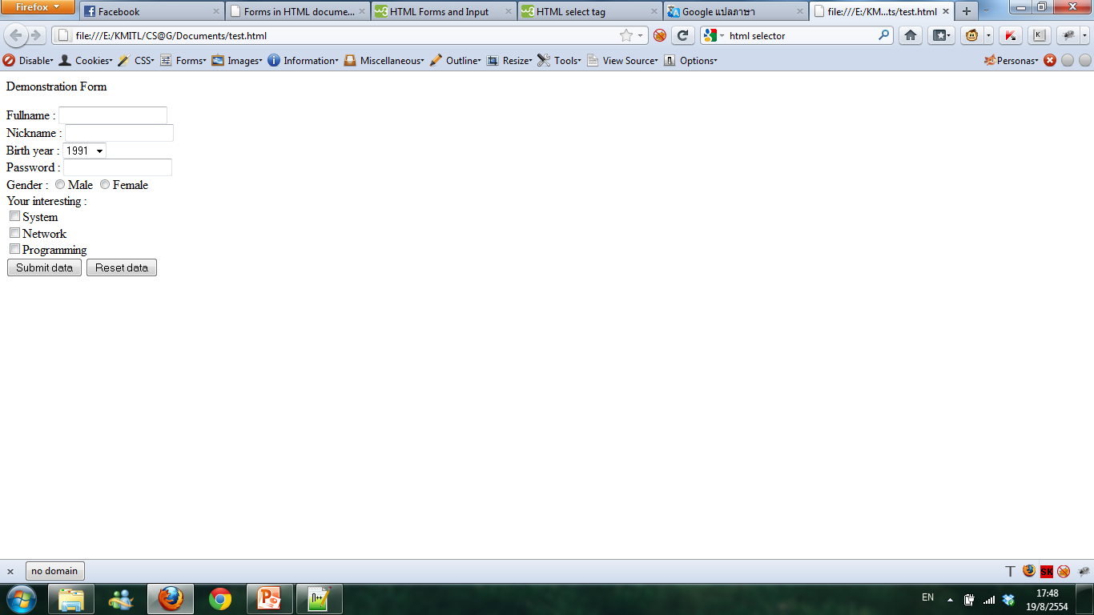
Select element
selector
<select name="year">
<option value="1991">1991</option>
<option value="1992">1992</option>
<option value="1993">1993</option>
<option value="1994">1994</option>
<option value="1995">1995</option>
</select>

Slide 27
Demonstration

Slide 28
Try it self !!!

Slide 29
Agenda
Loops
Introduction to forms
How to write form in HTML?
How to receive data in PHP?
Applications

Slide 30
How to receive data in PHP?
How to receive data in PHP
Example
Demonstration
Try it self !!!

Slide 31
How to receive data in PHP
GET
$_GET[..element name..];
Example :
<?php
$name=$_GET[“firstname”];
?>

Slide 32
How to receive data in PHP
POST
$_POST[..element name..];
Example :
<?php
$name=$_POST[“firstname”];
?>

Slide 33
How to receive data in PHP
Example :
<?php
$nick=$_GET[“nickname”];
echo “Hello ”.$nick;
?>
//input -> Q
//output -> Hello Q

Slide 34
How to receive data in PHP
Example :
<?php
$year=$_POST[“birth_year”];
$age=2011-$year;
if($age<20){
echo “You are child”;
}else{
echo “You are adult”;
}
?>
//input -> 1992
//output -> You are child

Slide 35
Demonstration

Slide 36
Try it self !!!

Slide 37
Agenda
Loops
Introduction to forms
How to write form in HTML?
How to receive data in PHP?
Applications

Slide 38
Applications
Example
Try it self !!!

Slide 39
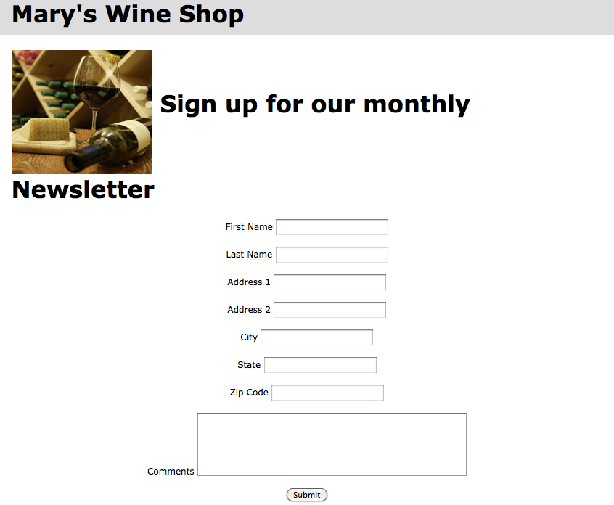
Applications

Slide 40
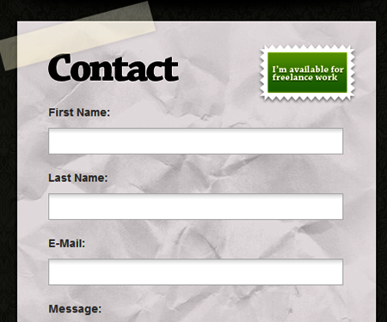
Applications

Slide 41
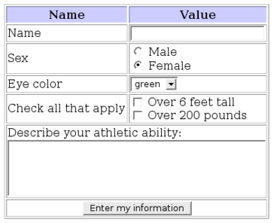
Applications

Slide 42
Applications
index.html :
<form action=“think.php”>
Input number only :
<input type=“text” name=“number” />
<input type=“submit” value=“Do” />
</form>
think.php :
<?php
$num=$_GET[“number”];
echo “Show number 1 to ”.$num;
for($i=1;$i<=$num;$i++){
echo “<br />”.$i;
}
?>

Slide 43
Try it self !!!

Slide 44
Summary

Slide 45
Question?

Slide 46
Thanks for coming today

Slide 47
References
http://www.w3.org/TR/html4/interact/forms.html
http://www.w3schools.com/html/html_forms.asp
http://www.w3schools.com/tags/tag_select.asp

